Slide 1


Slide 2
USERS & GROUPS
MANAGING LOCAL LINUX USERS AND GROUPS
Users and groups
Managing local user accounts
Managing user password
Creating supplementary groups
Managing group accounts
Managing group password, Adding, Removing users to and from the group
Super user access

Slide 3
USERS & GROUPS
User administration:
As an administrator, your most important job is to monitor and administrate users on a Linux network.
  In this chapter we are going to see-
    how to add a new user
    how to delete user
    how to add the user In a group.

Slide 4
USERS & GROUPS
UID:
UID 0 – reserved for the user ‘root’
UID 1-999 – reserved for the system user accounts
  Normal users start from UID 1000.
  Root user is called super user.
  Root users have unlimited access to all the files,devices and programs on the system.
  Root user has a complete control over the system.

Slide 5
USERS & GROUPS
Adding a new user:
Syntax :
useradd [options] username
Example :
useradd tom
Running useradd command is like editing the content of the following files:
/etc/passwd

Slide 6
USERS & GROUPS
/etc/passwd :
  passwd file is used to store user information.
  In this file, the following information stored-
      username
      password indicating (X)
      UID (user ID)
      GID (group ID)
      Comment line
      home directory
      shell

Slide 7
USERS & GROUPS
Set a password for the user
Password information can be saved in /etc/shadow file.
Syntax :
passwd <-options> [username]
Options:
-d delete
-l lock
-u unlock
Example :
passwd tom

Slide 8
USERS & GROUPS
/etc/shadow :
  Shadow file used to password aging information for each user. It contains the following-
root : $1$QKjRxrXYgc98F: 12825 : 0 : 99999 : 7 : : :
      username
      encrypted password
      last change password
      minimum no. of days to change password
      maximum no. of days to change password
      warning days to change password
      password inactive date
      account expiry date

Slide 9


Slide 10
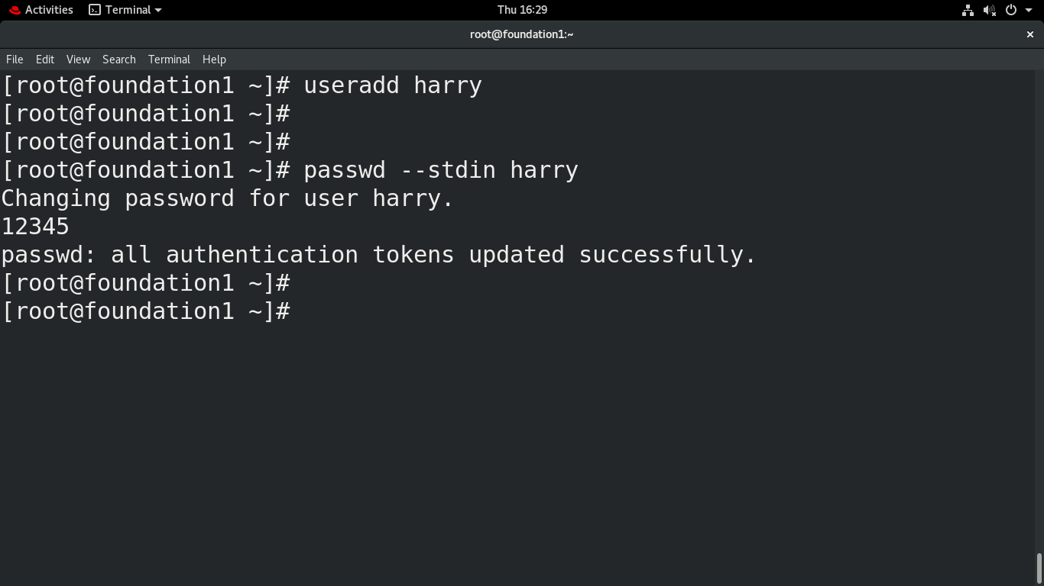
USERS & GROUPS
Add a user
Set the password for the user
Administer Users & Groups

Slide 11
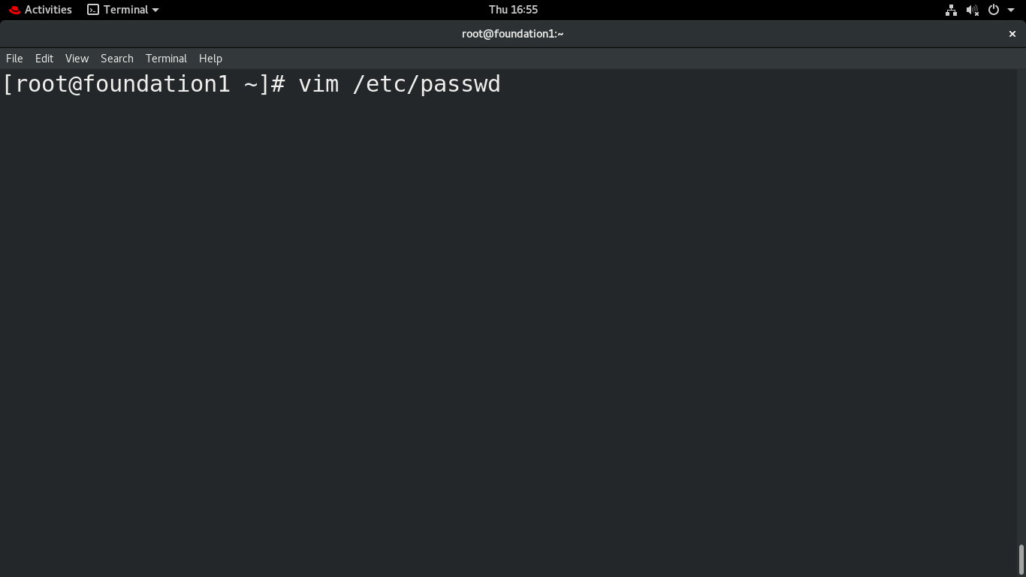
USERS & GROUPS
To view the
user accounts file
Administer Users & Groups

Slide 12
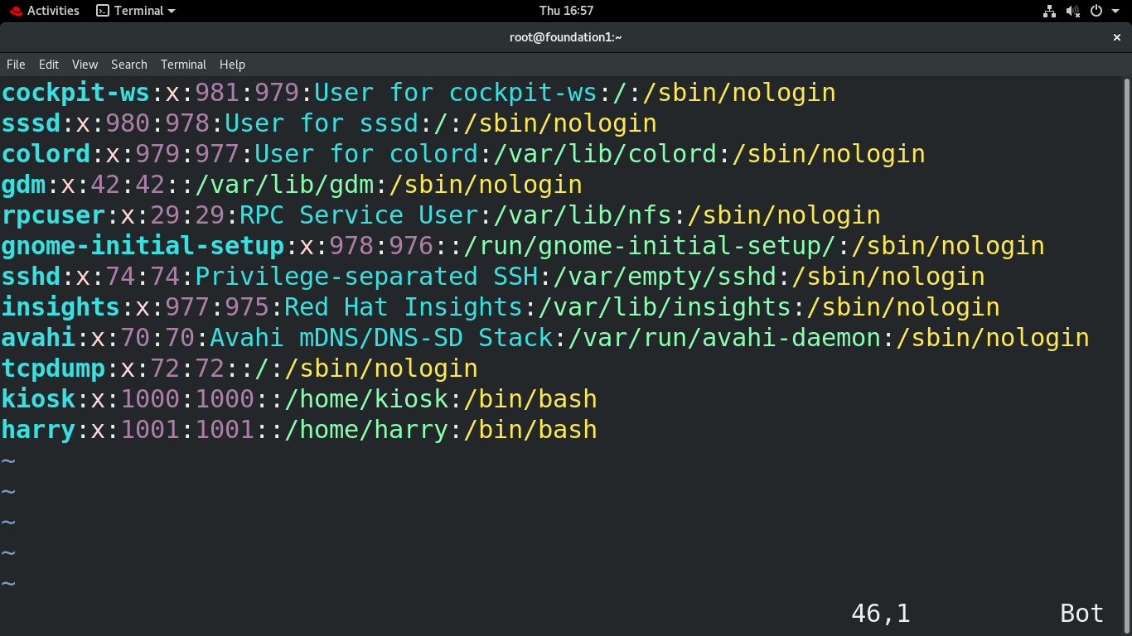
USERS & GROUPS
Administer Users & Groups

Slide 13
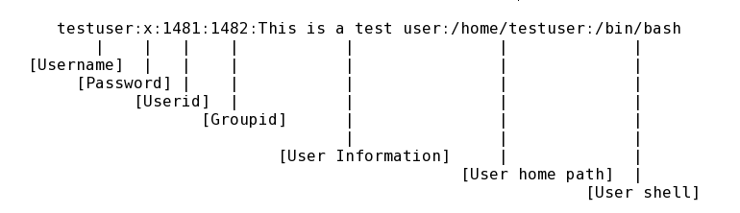
USERS & GROUPS
To view the
user details
Administer Users & Groups

Slide 14
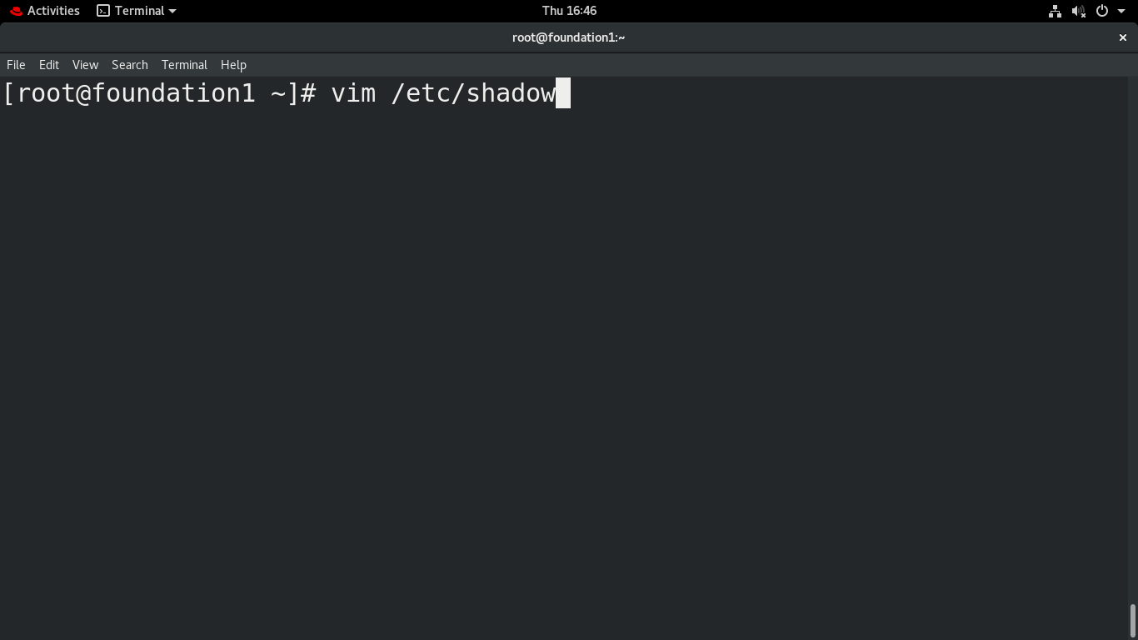
USERS & GROUPS
To view the User Password file
Administer Users & Groups

Slide 15
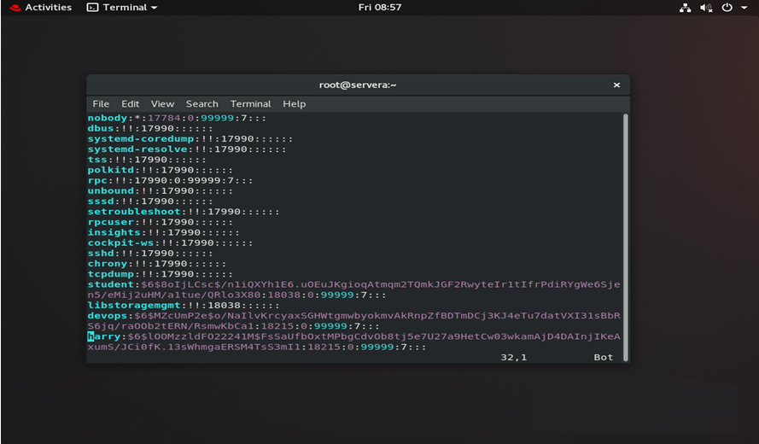
USERS & GROUPS
See the encrypted password

Slide 16
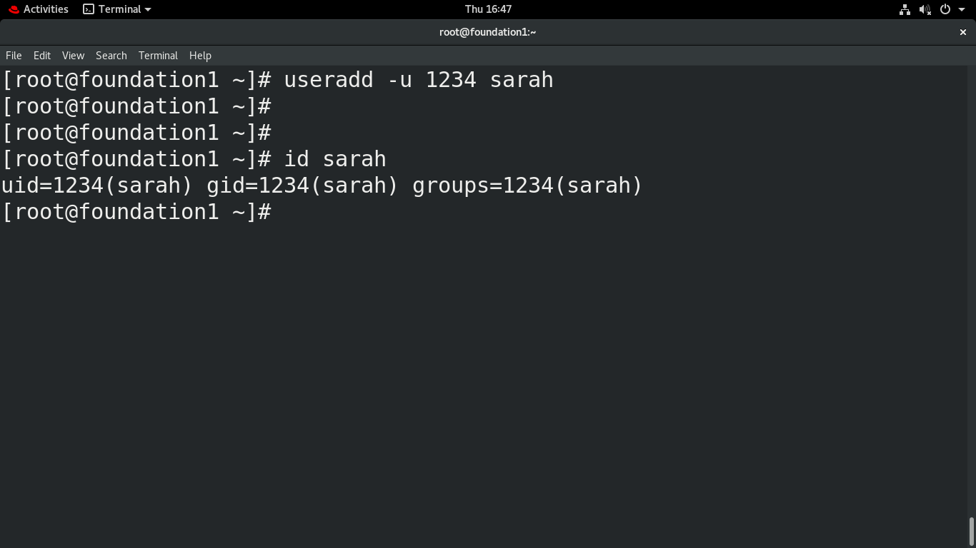
USERS & GROUPS
Adding a user
With id
Check for the presence of the user

Slide 17
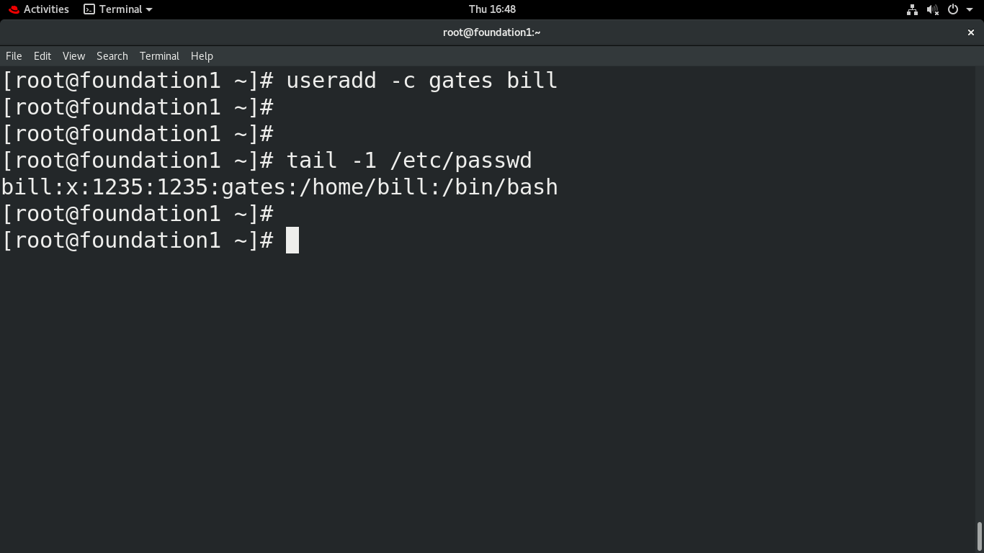
USERS & GROUPS
Adding a user
With comment

Slide 18
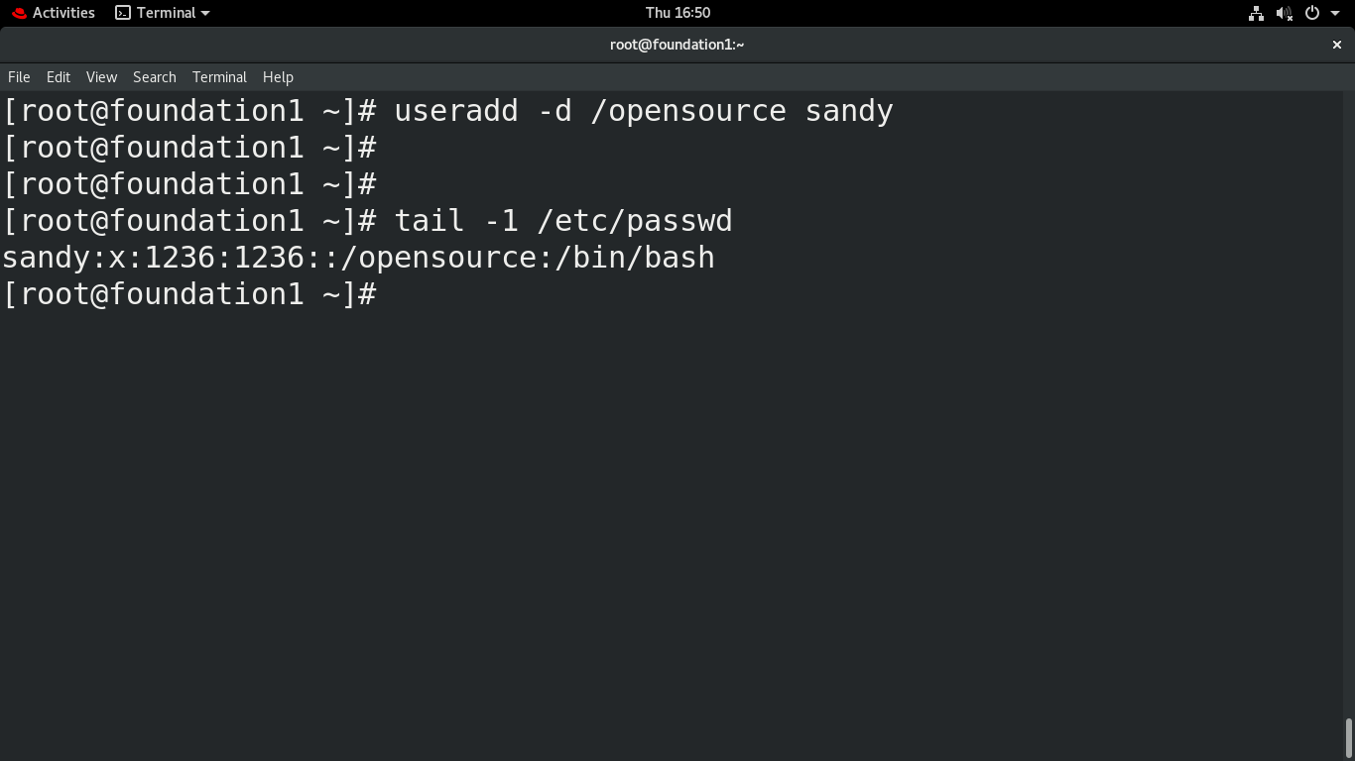
USERS & GROUPS
Adding a user
With home directory

Slide 19
User modification

Slide 20
USERS & GROUPS
usermod:
It is used to modify the user account information.
Syntax:
usermod <-options> username
Options:
-u uid -d directory
-g gid -s shell
-c comments
Example :
usermod –u 1000 –g 1000 tom

Slide 21
USERS & GROUPS
-c = We can add the comment field for the user account.
-d = To modify the directory for any existing user account.
-e = Using this option we can make the account expiry in a specific period.
-g = Change the primary group for a User.
-G = To add supplementary groups.
-a = To add anyone of the group to a secondary group.
-l = To change the login name from user1 to user1_admin.
-L = To lock the user account. This will lock the password so we can’t use the account.

Slide 22
USERS & GROUPS
-m = Moving the contents of the home directory from the existing home dir to the new dir.
-p = To Use an un-encrypted password for the new password. (NOT Secured).
-s = Create a Specified shell for new accounts.
-u = Used to Assigned UID for the user account between 0 to 999.
-U = To unlock the user accounts. This will remove the password lock and allow us to use the user account.

Slide 23
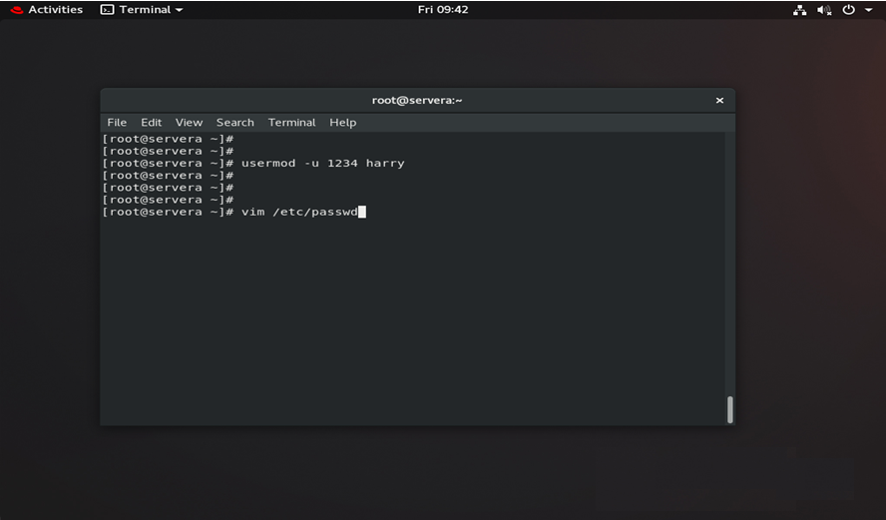
USERS & GROUPS
modify the User ID

Slide 24
USERS & GROUPS
To view the
user accounts
Administer Users & Groups

Slide 25
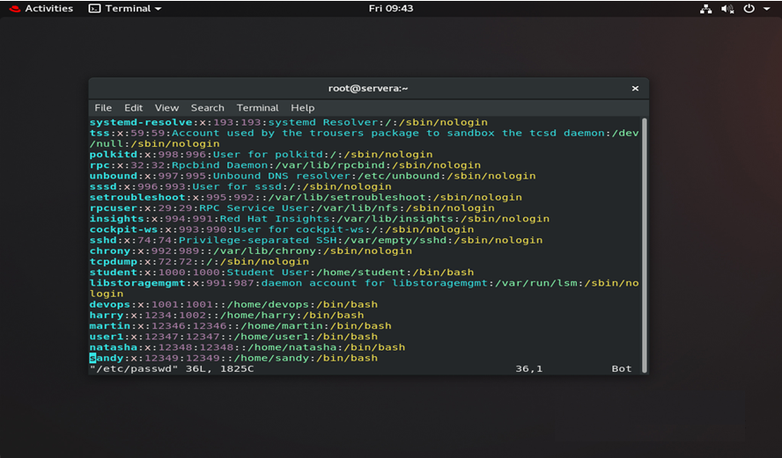
USERS & GROUPS
user ID changed

Slide 26
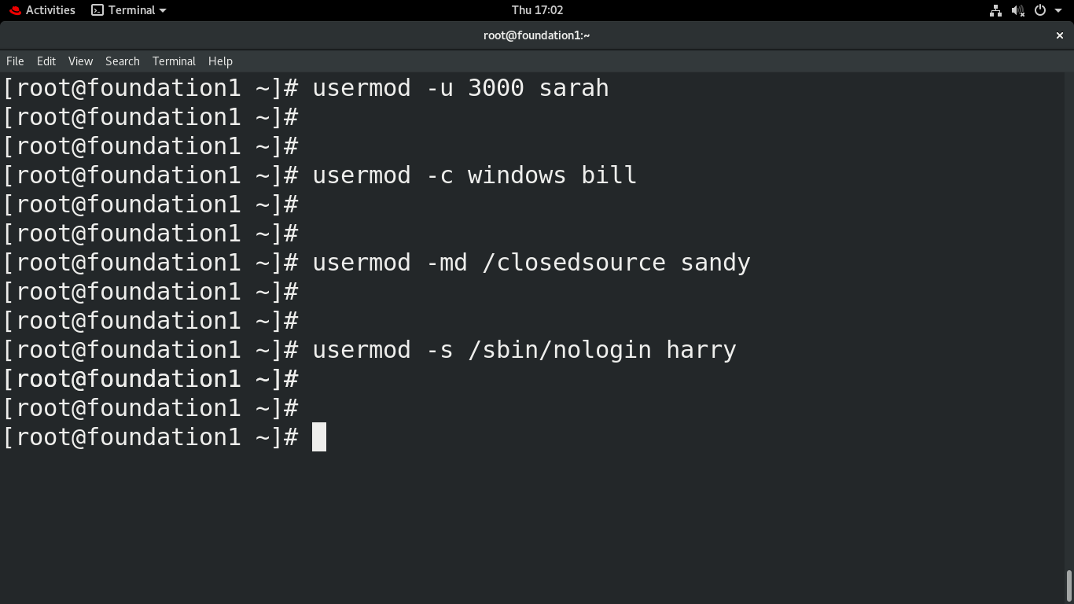
USERS & GROUPS
modify the uid, comment, directory, shell

Slide 27
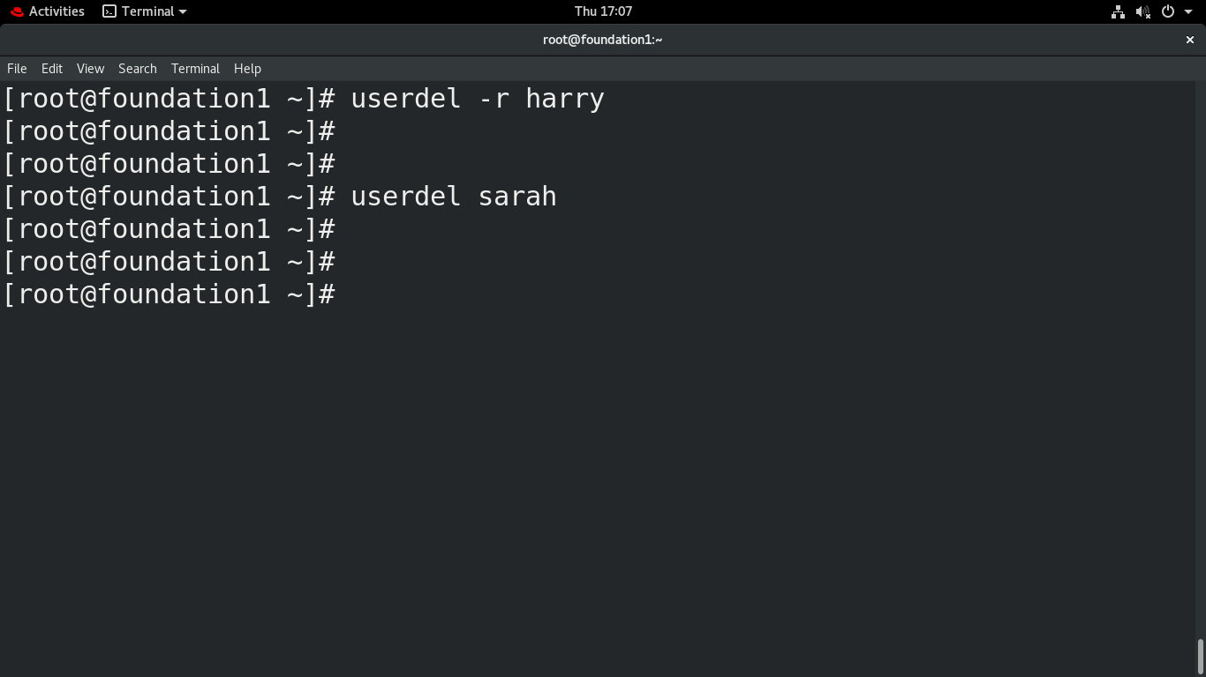
USERS & GROUPS
Delete the user with home directories
Delete user without homedir

Slide 28
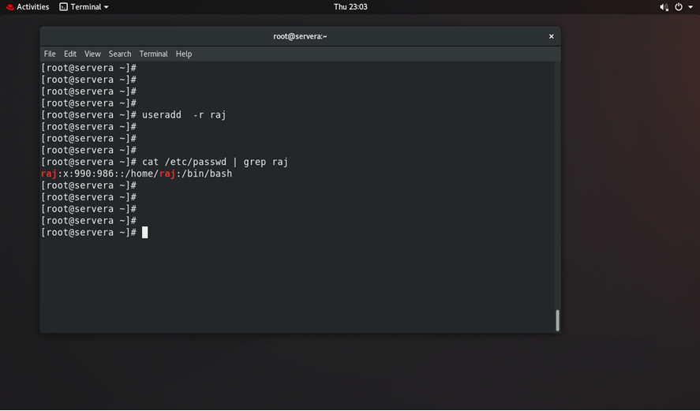
USERS & GROUPS
Create a system user
Check his id is in the range of system users

Slide 29
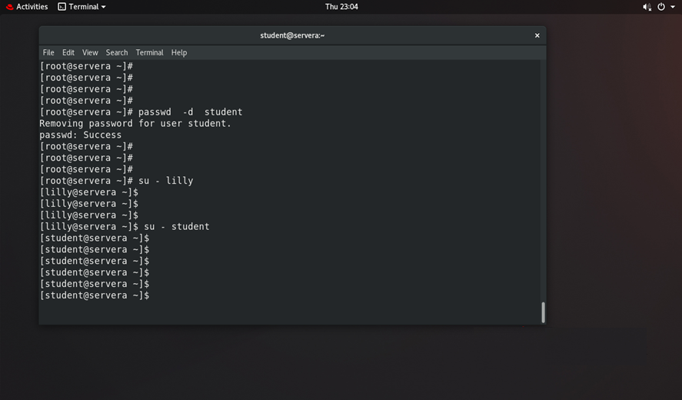
USERS & GROUPS
Remove the password of student user
Login to student from standard user without password

Slide 30
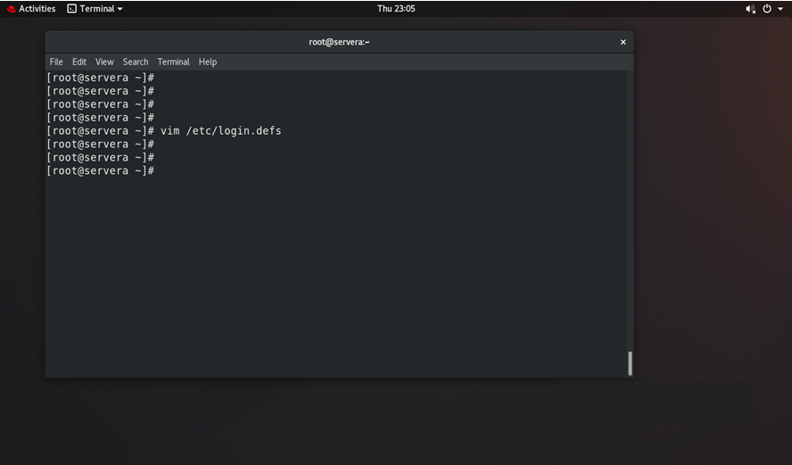
USERS & GROUPS
Users id’s and password expiry cofiguration file

Slide 31
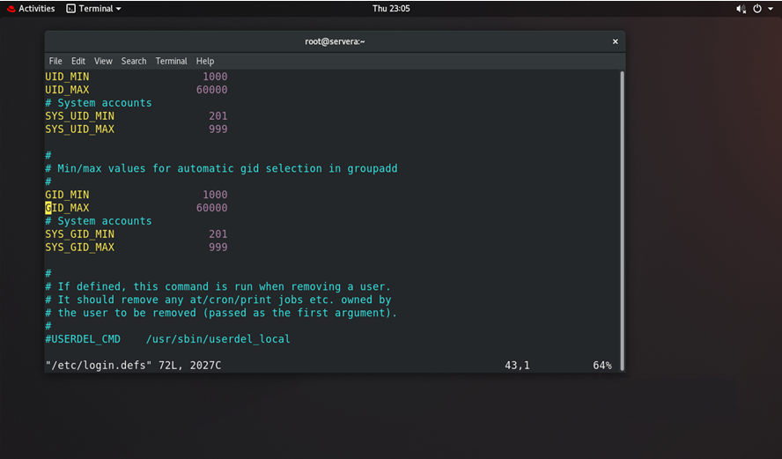
USERS & GROUPS
Users id’s and password expiry cofiguration file

Slide 32
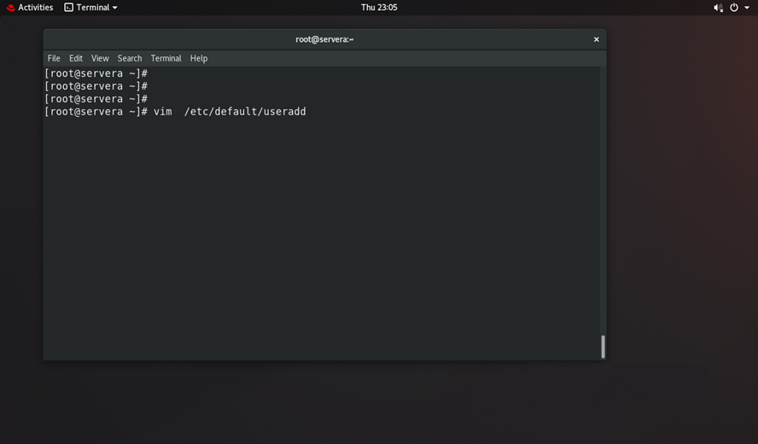
USERS & GROUPS
The default file executes when a user is creating

Slide 33
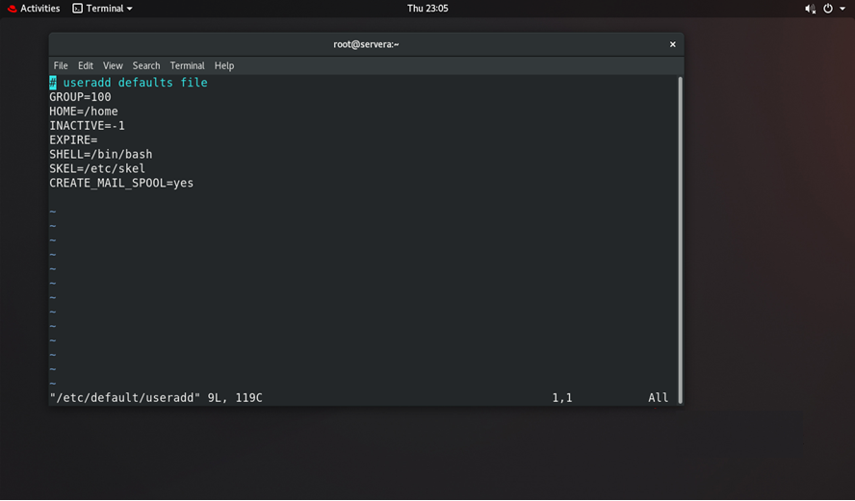
USERS & GROUPS
The default file executes when a user is creating

Slide 34


Slide 35
USERS & GROUPS
Adding a new group:
This command is used to add a new group to Linux.
Syntax:
groupadd <groupname>
Example:
groupadd data

Slide 36
USERS & GROUPS
GID:
  Group IP 0 reserved for root group.
  Group ID range 1-999 for user service and
  program groups.
  Normal groups start from ID 1000

Slide 37
USERS & GROUPS
/etc/group :
It shows the group information for each user.
Example:
root:x:tom
    group name
    encrypted password
    group members

Slide 38
USERS & GROUPS
groupmod:
It is used to modify a group.
Syntax:
groupmod <-options> < newname>
Options:
-n rename
-g group ID
Example:
groupmod –g 1000 data

Slide 39
USERS & GROUPS
Removing the group :
This command is used to delete a group.
Syntax:
groupdel <groupname>
Example:
groupdel data
delete the group by this command

Slide 40
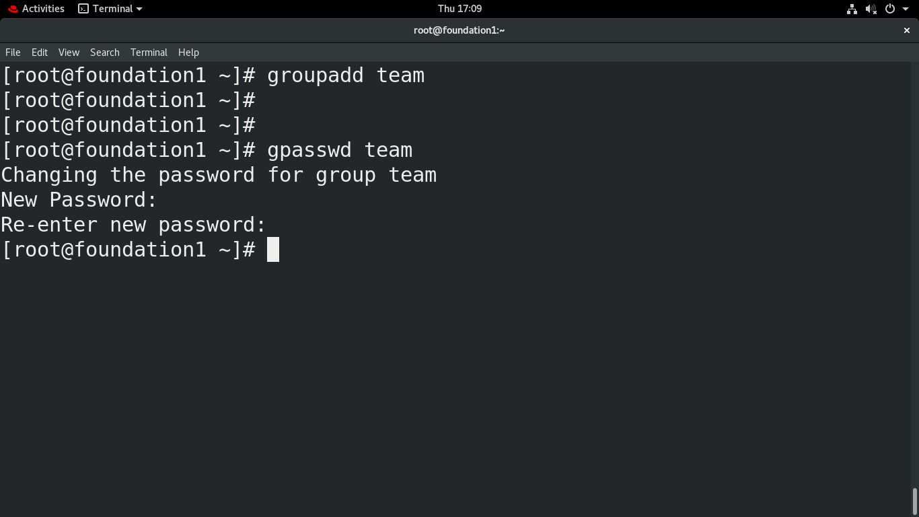
USERS & GROUPS
Add a group
Set password for the group
Administer Users & Groups

Slide 41

USERS & GROUPS
To view the
group accounts
Administer Users & Groups

Slide 42
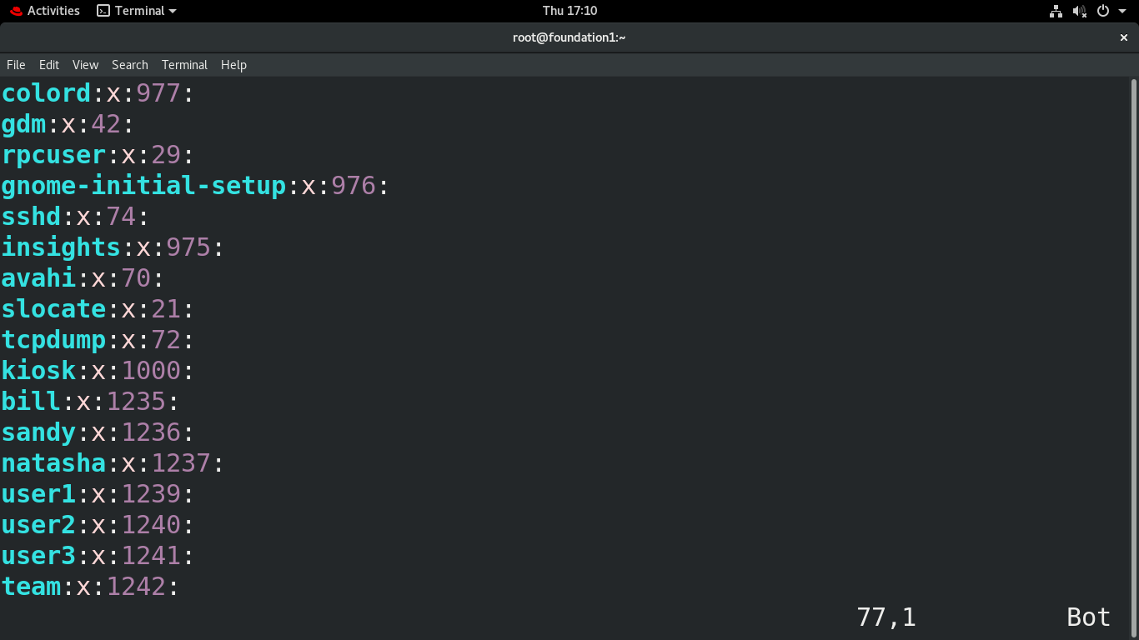
USERS & GROUPS
Administer Users & Groups
Group added

Slide 43
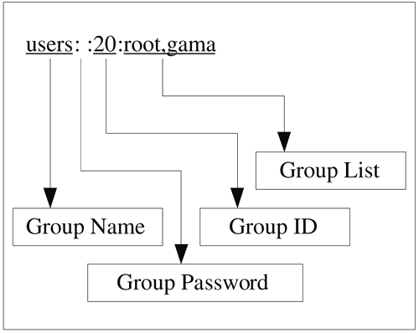
USERS & GROUPS
To view the
Group details
Administer Users & Groups

Slide 44
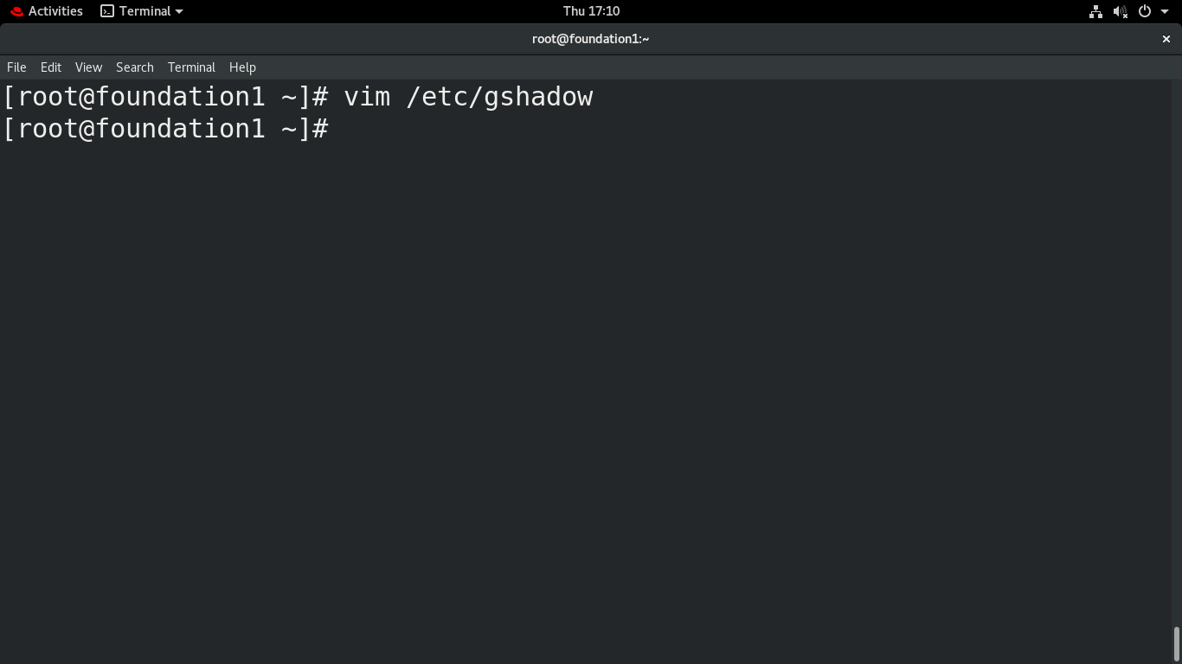
USERS & GROUPS
To view the group Password
Administer Users & Groups

Slide 45
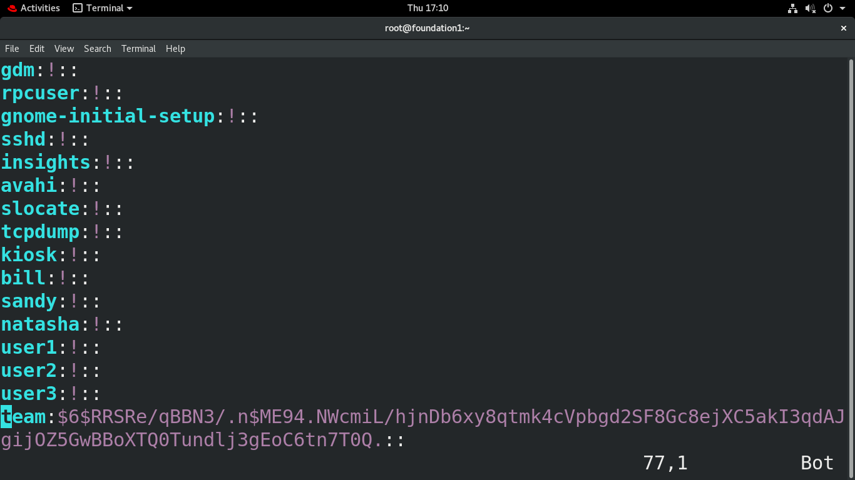
USERS & GROUPS
Administer Users & Groups
To view the group Password

Slide 46
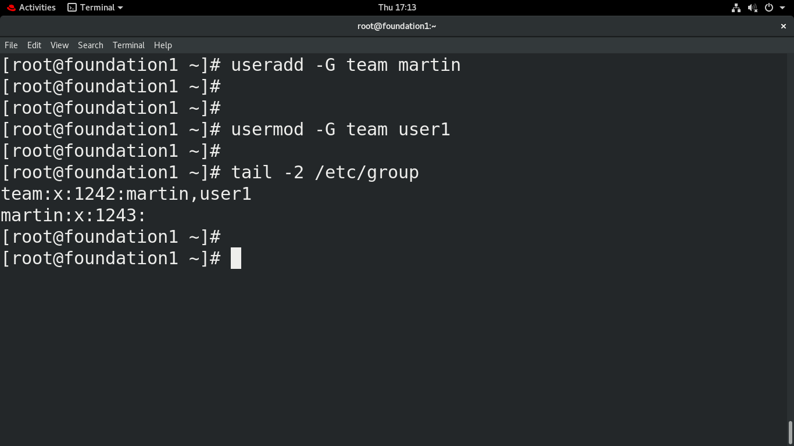
USERS & GROUPS
To add user into a group
Administer Users & Groups

Slide 47
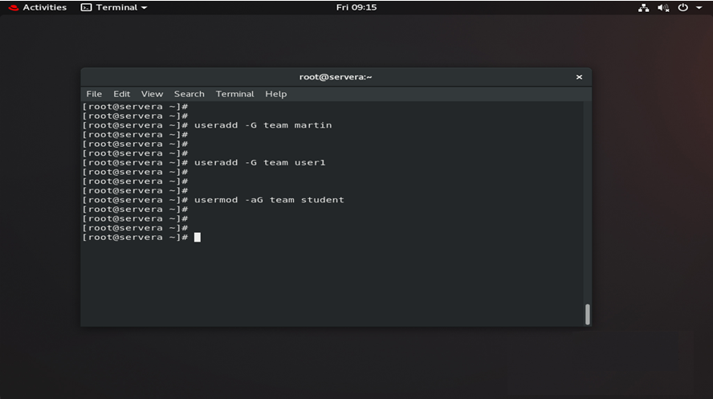
USERS & GROUPS
Adding a user in group
Append user to the group from other group

Slide 48
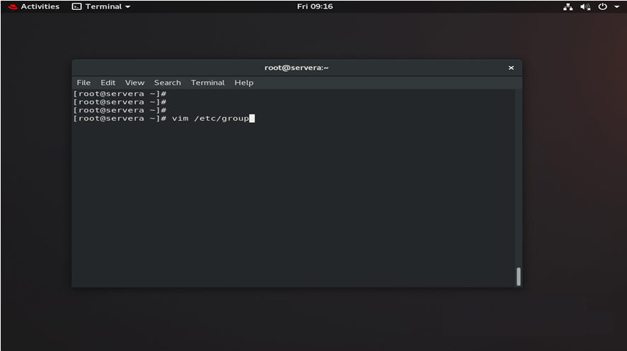
USERS & GROUPS
Open the group configuration file

Slide 49
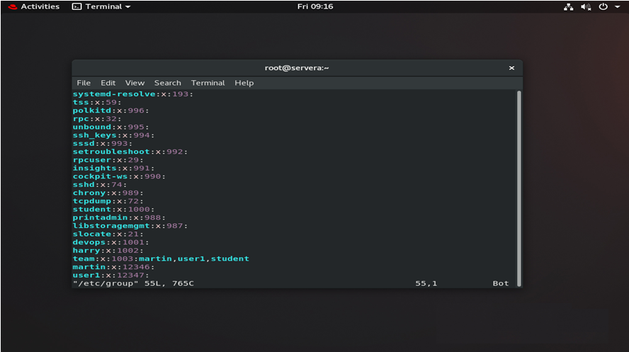
USERS & GROUPS
User student in
Multiple group

Slide 50
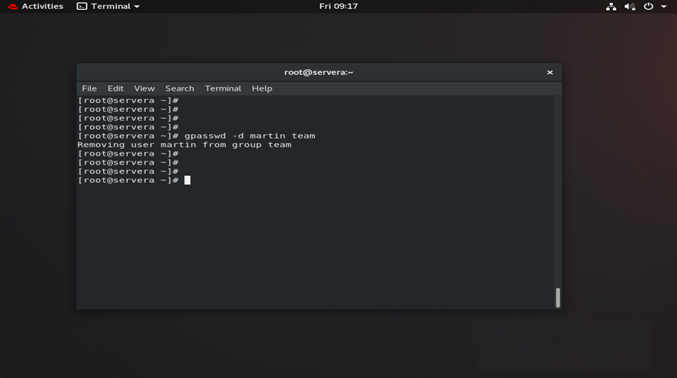
USERS & GROUPS
delete user in group

Slide 51
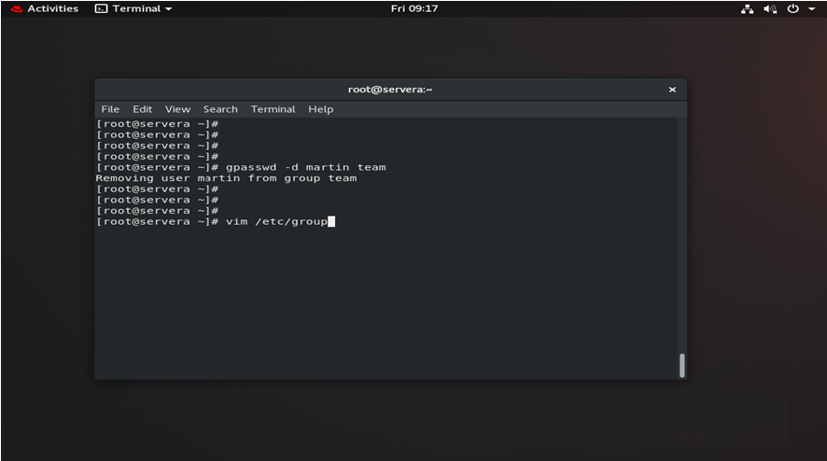
USERS & GROUPS
Check in the group configuration file

Slide 52
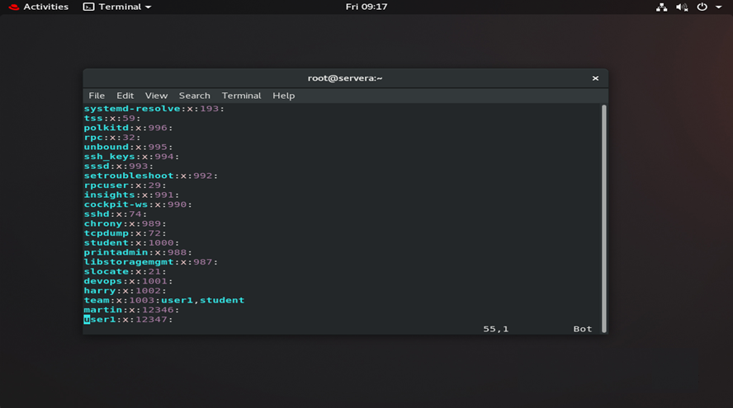
USERS & GROUPS
Check in the group configuration file

Slide 53
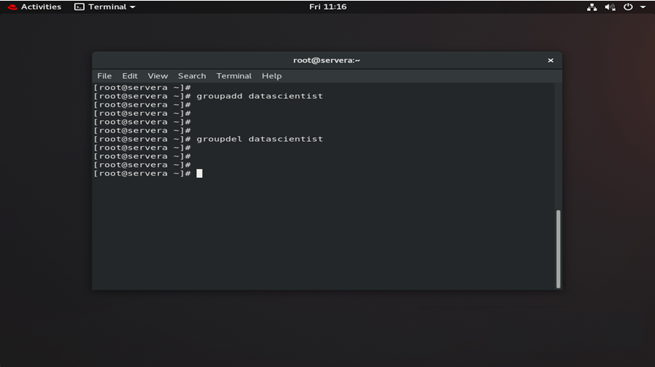
USERS & GROUPS
delete a group

Slide 54
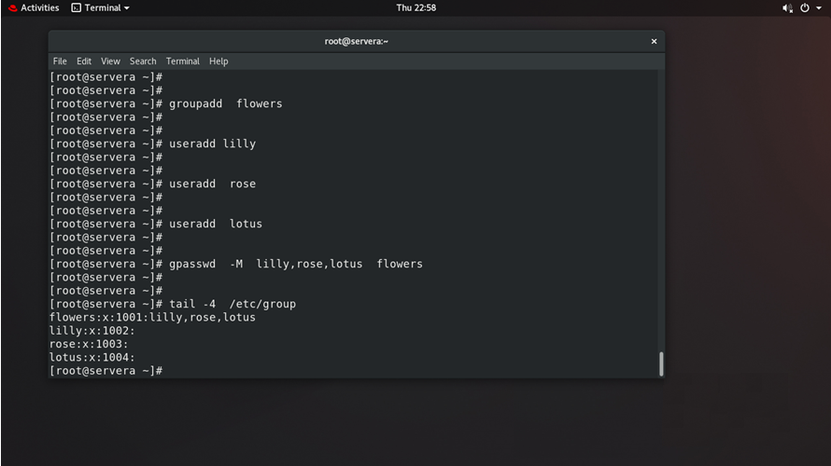
USERS & GROUPS
Add multiple users in a group

Slide 55
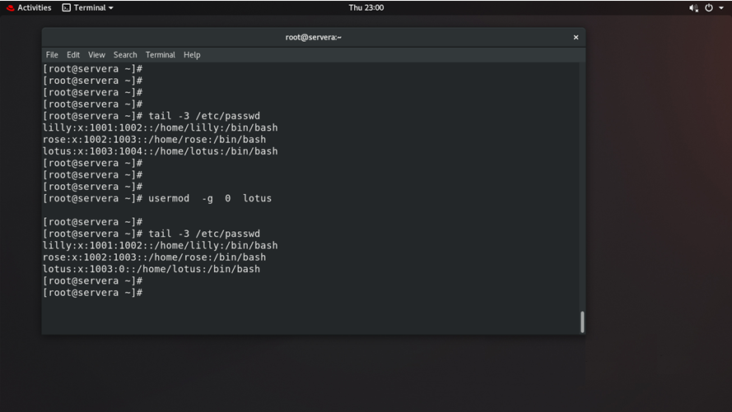
USERS & GROUPS
Change the primary group id of user

Slide 56
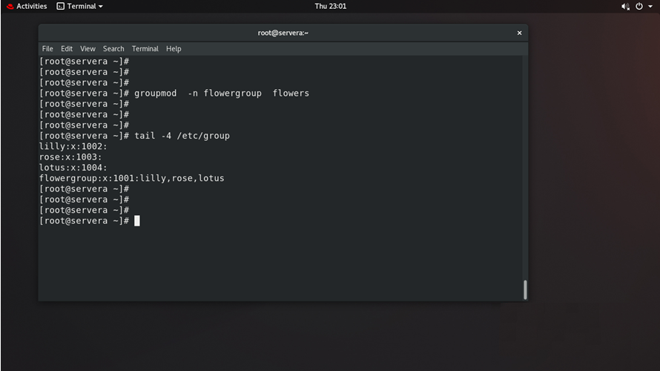
USERS & GROUPS
Rename the group

Slide 57
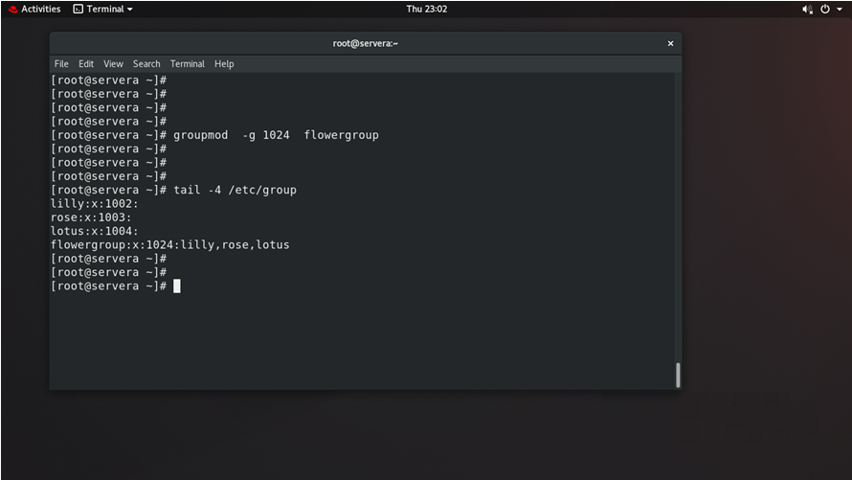
USERS & GROUPS
Change the group id

Slide 58
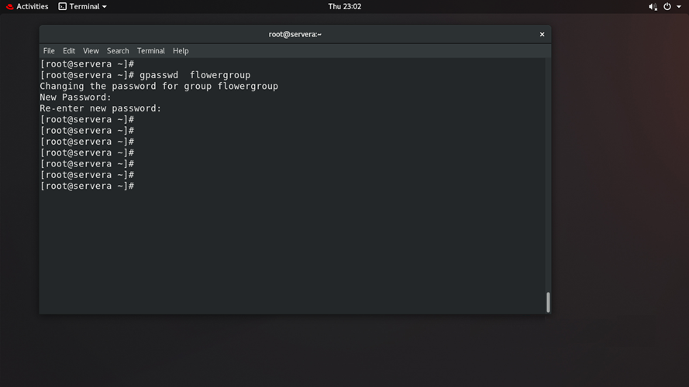
USERS & GROUPS
Set password for th group

Slide 59
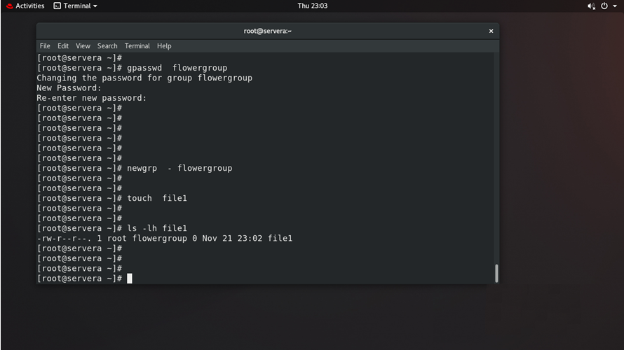
USERS & GROUPS
Login into the group and create a file

Slide 60
USERS & GROUPS
userdel :
It is used to delete the user account.
Syntax:
userdel <-options> <username>
Options :
-f Force
-r Remove
Example :
userdel –r tom

Slide 61
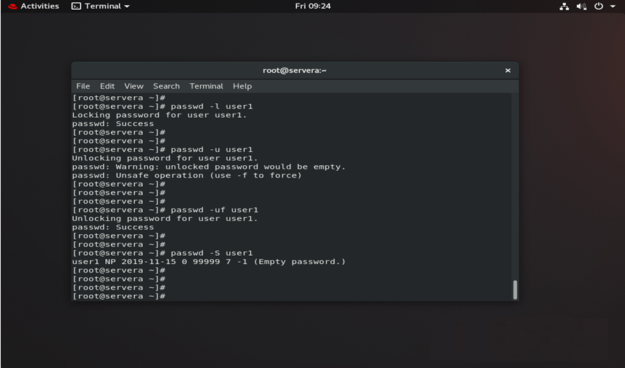
USERS & GROUPS
To lock, unlock
user accounts

Slide 62
USERS & GROUPS
SUPER USER ACCESS :
The Sudo command offers a mechanism for providing trusted users with administrative access to a system without sharing the password of the root user.
Administer Users & Groups

Slide 63
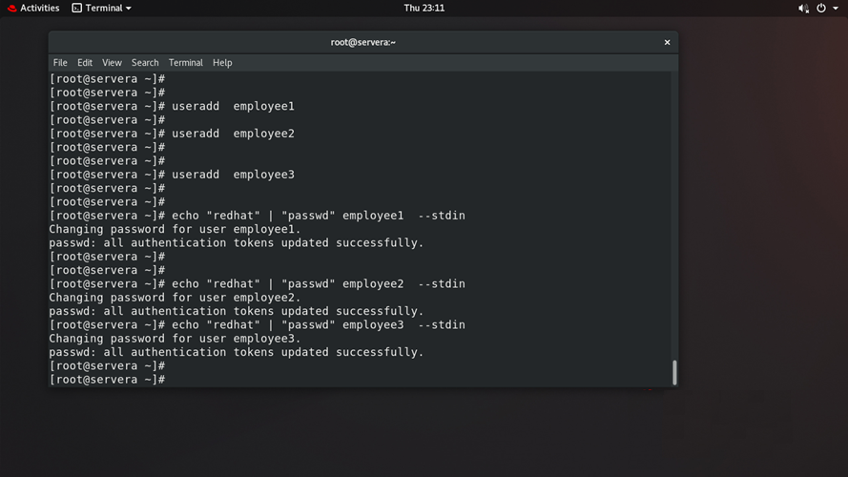
USERS & GROUPS
Creating the user
Set the password

Slide 64
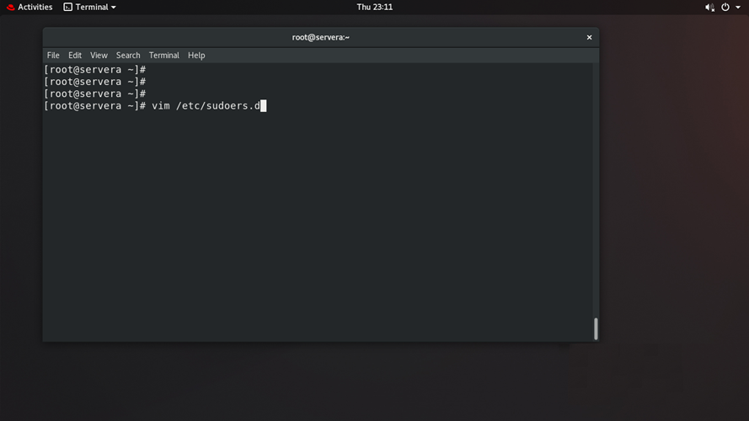
USERS & GROUPS
Open the sudoers configuration file

Slide 65
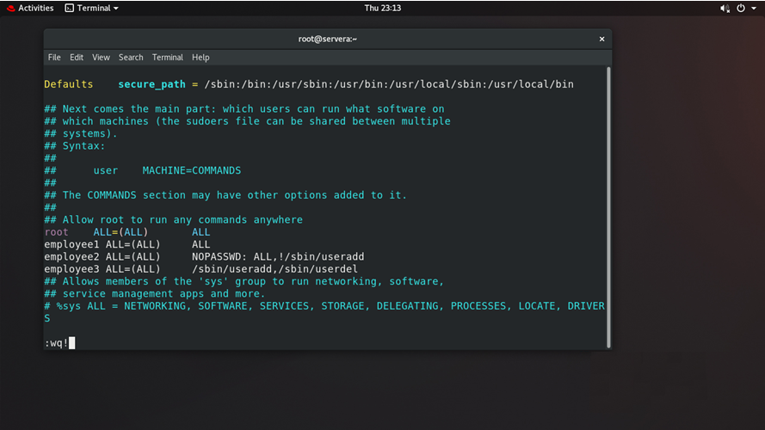
USERS & GROUPS
Entry for the sudo users

Slide 66
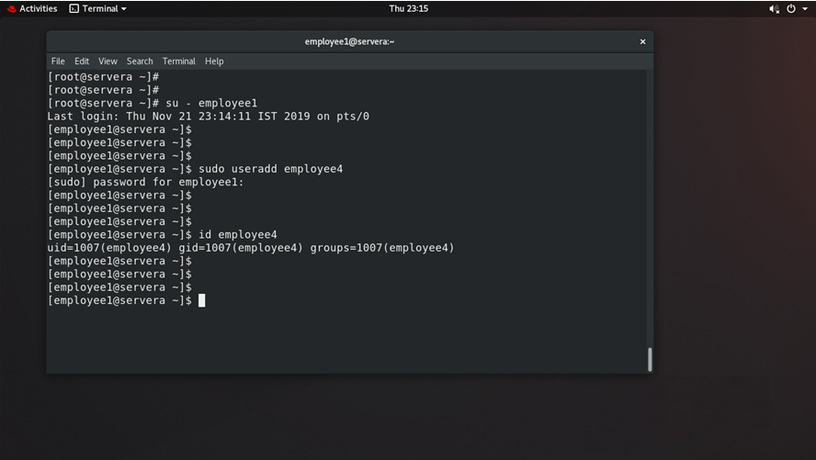
USERS & GROUPS
Employee can able to execute all the commands

Slide 67
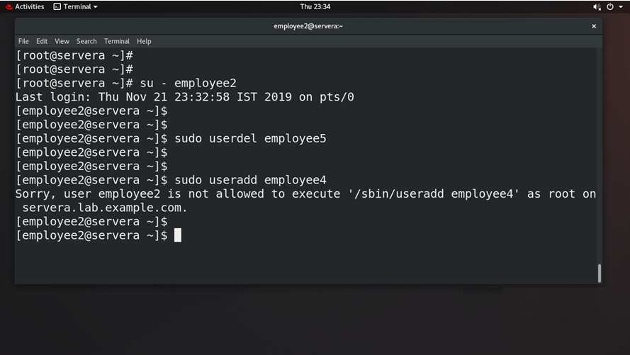
USERS & GROUPS
Employee can’t add a user

Slide 68
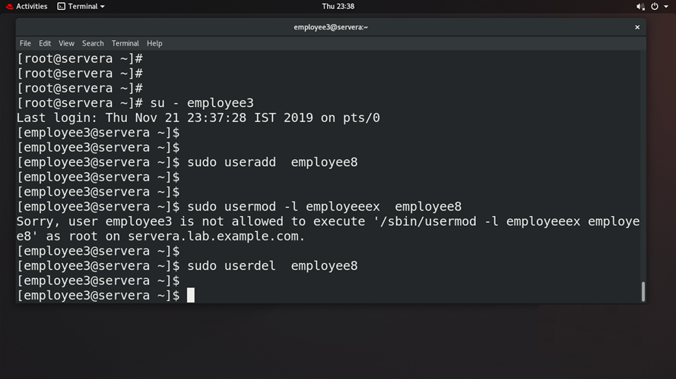
USERS & GROUPS
Employee3 can add and delete users only but cant’t modify

Slide 69


